Slide 1
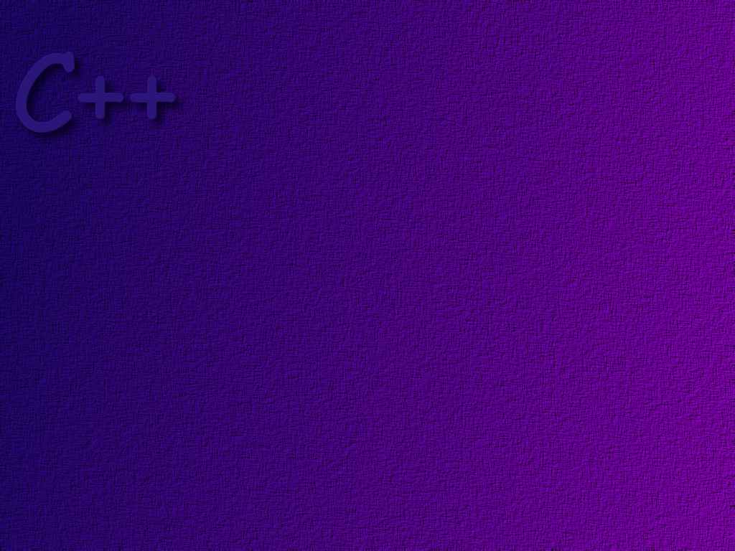
Template Case Study

Slide 2
Container Classes
Recall that class templates are most often used
to create Container Classes – that is objects that
can hold other data elements in some organized way.

Slide 3
C++ Arrays
There are two distinct problems with
C++ Arrays.
They are fixed in size once declared
It is easy to overflow array boundaries

Slide 4
Problem
Create a Safe_array Template
We will do a simple case for this exercise.
If index out of the array bounds, we will
throw an exception. We will not re-size the
array – if we did this would be like a vector.
We will also provide an iterator to move
through the array.

Slide 5
Iterators
An iterator is an object that works sort of like a pointer. Iterators are used to move sequentially through elements in a container
We want our iterator to be parameterized
You can do arithmetic on iterators
for (Iterator<int> i = a.begin( ); i != a.end( ); i++)
cout << *i << endl;
You can compare
iterators
You can de-reference iterators
This is a function that
returns an iterator to
the end of “a”
This is a function that
returns an iterator to
the beginning of “a”

Slide 6
The Design
Internally, we need someplace to store the elements
of our Safe_array. What would you use?
An array.
So …. the data members of this class template
might be what?
an Array of T ← because we want the data type parameterized
an integer to hold the size of the array

Slide 7
template <class T>
class Safe_array
{
private:
int size;
T sa[ n ];
public:
. . .
};

Slide 8
Problem: We don’t know how much storage to allocate until
a Safe_Array object is instantiated. How can we solve this
problem?
Solve the problem by dynamically allocating the storage
for the Safe_Array object when it is constructed.
Does this suggest another issue we have to worry about?
Yes, we have to have a destructor to return the dynamically
allocated storage to the heap when we are done with it.

Slide 9
template <class T>
class Safe_array
{
private:
int size;
T* sa; // change to a T*
public:
Safe_Array( int ); // allocate space
~Safe_Array ( ); // give it back
. . .
};

Slide 10
What functions will we need in our Safe_array class?
Basically, we just need to store data in an
element of the array and retrieve data from
an element of the array.
We could write a “getter” and a “setter”
function to do this, for example . . .
a = mySafeArray.get( 5 );
Do you like this?

Slide 11
It would be really neat if we could write
a = mySafeArray[ 5 ];
Can you figure out a way to do this?
Overload the [ ] operator!

Slide 12

How?
Consider the statement
a = mySafeArray[5];
So the function of the [ ]
operator is to take the index
as a parameter and and return
the value at that location in
the array.
And then assign that value to a.
this side of the assignment
operator says … get the element
at index 5 from the array.
Don’t forget the case where the index
is outside the boundaries of the array.

Slide 13
What about mySafeArray[ 5 ] = a;
If we could get a reference to the element at
index 5 of the array, we could store the value
of a there.

Slide 14
template <class T>
class Safe_array
{
private:
int size;
T* sa; // change to a T*
public:
Safe_Array( int ); // allocate space
~Safe_Array ( ); // give it back
T& operator[ ] (int index);
. . .
};
takes the index as
A parameter
returns a T reference

Slide 15
Getting an Iterator
We need a pair of functions in the Safe_array class
that return iterators, one that points to the
beginning of the array, and one that points to the
end.

Slide 16
template <class T>
class Safe_array
{
private:
int size;
T* sa; // change to a T*
public:
Safe_Array( int ); // allocate space
~Safe_Array ( ); // give it back
T& operator[ ] (int index);
const Iterator<T> begin( ); // points to start of array
const Iterator<T> end( ); // points to end of array
};

Slide 17
The Iterator Class
We need the iterator to “point” to an element in the array.
What does this suggest about one of its data members?
It is a T*
So, the Iterator class must be parameterized.

Slide 18
template <class T>
class Iterator
{
private:
T* position;
. . .
};
Do we need any additional data members?
No!

Slide 19
Iterator Functions
You can do arithmetic on iterators
overload ++ operator
for (Iterator<int> i = a.begin( ); i != a.end( ); i++)
cout << *i << endl;
You can compare iterators
You can de-reference iterators
overload == and != operators
overload * operator (a unary operator)
This is a function that
returns an iterator to
the beginning of “a”
This function belongs to the Safe_array class.

Slide 20
template <class T>
class Iterator
{
private:
T* position;
public:
Iterator( );
Iterator<T> operator++(int);
bool operator==(const Iterator<T>&);
bool operator!=(const Iterator<T>&);
T operator*( );
. . .
};

Slide 21
Is that all?
What about a destructor?
Be careful … you don’t want to accidentally
delete the data that the iterator points to.
We need to be able to set the address in the
Iterator object to point to something.
void setPosition (T*);

Slide 22
template <class T>
class Iterator
{
private:
T* position;
public:
Iterator( );
~Iterator( );
Iterator<T> operator++(int);
bool operator==(const Iterator<T>&);
bool operator!=(const Iterator<T>&);
T operator*( );
void setPosition (T* );
};

Slide 23
Implementation
The Iterator Template

Slide 24
The constructor
Iterator( )
{
}
position = NULL;
When we create an
Iterator, we don’t want
it to point to anything.

Slide 25
Overloading the post-increment operator
Iterator<T> operator++( int )
{
}
Iterator<T> t = *this;
position++;
return t;
The expression containing the
Iterator is evaluated first, then
the position inside the iterator
is incremented.

Slide 26
Overloading the de-reference operator
T operator* ( )
{
}
return *position;
This has to return the data
element pointed to by the
Iterator.

Slide 27
Overloading the == operator
bool operator== (const Iterator<T>& b )
{
}
if ( position == b.position )
return true;
else
return false;
Compare the positions.

Slide 28
Overloading the == operator
bool operator!= (const Iterator<T>& b )
{
}
if ( position != b.position )
return true;
else
return false;
Compare the positions.

Slide 29
The setPosition( ) function
void setPosition (T* newPos )
{
}
position = newPos;

Slide 30
Implementation
The Safe_array Template

Slide 31
The constructor
Safe_array( int capacity)
{
}
sa = new T[ capacity];
size = capacity;
When we create a
Safe_Array, we need
to allocate the array.

Slide 32
The destructor
~Safe_array( )
{
}
delete [ ] sa;
Delete the dynamically
allocated array.

Slide 33
Overloading the [ ] operator
T& operator[ ] ( int index )
{
}
if ( index >= size || index < 0 )
throw outOfBoundsException( );
else
return sa [ index ];
Handle out of bounds errors!

Slide 34
The begin ( ) function
const Iterator<T> begin( )
{
}
Iterator<T> anIterator;
anIterator.setPosition(sa);
return anIterator;
Create an iterator and
set its position to the
start of the array.

Slide 35
The end ( ) function
const Iterator<T> end( )
{
}
Iterator<T> anIterator;
anIterator.setPosition(sa + size);
return anIterator;
Create an iterator and
set its position to the
end of the array. By convention
This is one element past the last
element in the container.

